Slide 1
Exploring the Efficacy of Generative Pretrained Transformers for Arithmetic Problem Solving: A Comparative Analysis
- Mohit Pawaskar

Slide 2

Index
Introduction
Research Scope
Objectives
Methodology
Results and Analysis
Conclusion

Slide 3





Introduction
This research shows that big language models struggle with math. I investigated different factors and used LLM-based models to do complex arithmetic accurately without calculators.
Surprisingly, even ChatGPT had difficulty with multi-digit multiplication. I tested various LLM-based modules like COHERE, GEMMA, Meta-Llama, and ZEPHYR for accuracy. Additionally, I configured the deployment of DeepSeekMaths and tested different arithmetic operations for accuracy.

Slide 4
Research Scope
Examination of GPT models, including COHERE, GEMMA, ZEPHYR, Meta-Llama, ChatGPT and DeepSeekMath.
Focus on comprehension and reasoning abilities of GPT models in handling mathematical problems.
Task | Integer | Decimal | Fraction | Percentage | Negative Numbers
Addition | nD + nD | nD.mD + nD.mD | (nD/mD) + (nD/mD) | nD% + nD% | -nD + -nD
Subtraction | nD - nD | nD.mD - nD.mD | (nD/mD) - (nD/mD) | nD% - nD% | -nD - -nD
Multiplication | nD * nD | nD.mD * nD.mD | (nD/mD) * (nD/mD) | nD% * nD% | -nD * -nD
Division | nD / nD | nD.mD / nD.mD | (nD/mD) / (nD/mD) | nD% / nD% | -nD / -nD
Exponentiation | nDˆnD | - | - | - | -nDˆ-nD
Mixed Computing | [(nD±nD.mD)*nD%]/-nD | - | - | - | -

Slide 5
Objectives:
Evaluate correctness and accuracy of GPT models' solutions to mathematical problems.
Compare performance across different types of mathematical problems.
Explore implications of GPT models' proficiency in mathematics for education and real-world applications.

Slide 6
Methodology:
Utilization of GPT models' LLM modules for arithmetic operations.
Assessment of addition, subtraction, multiplication, division, exponentiation, and mixed operations.
Comparison of accuracy and performance metrics among GPT models.

Slide 7

Results and Analysis:
Presentation of accuracy scores and performance metrics for each GPT model.
Analysis of strengths and weaknesses in handling different types of mathematical operations.
Interpretation of findings in the context of potential implications for education and problem-solving.

Slide 8
Results
Model | Accuracy
Chat GPT | 50%
Cohere | 50%
Gemma | 27%
Zephyr | 37%
Meta-Llama | 40%
DeepSeekMath | 55%

Slide 9
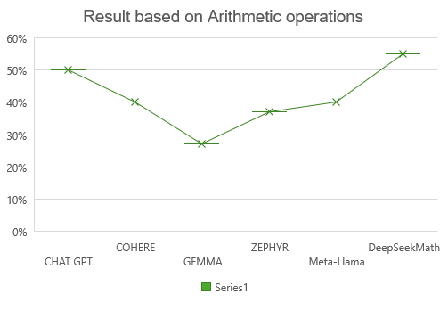
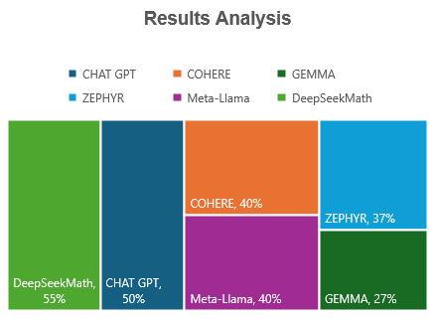
Results

Slide 10
Conclusion
Our study highlights the effectiveness of Large Language Models (LLMs), including DeepSeekMath-7B-instruct, ChatGPT, COHERE, GEMMA, ZEPHYR, and Meta-Llama, in addressing arithmetic tasks and math word problems. Through rigorous experiments and API development, we demonstrate their utility.
1. Performance Evaluation: We evaluated the performance of various LLMs on arithmetic tasks and math word problems.
2. Model Comparison: We compared different LLMs, showcasing their strengths and limitations.
3. API Development: We developed an API leveraging the GPT model, particularly DeepSeekMath-7B-instruct, for arithmetic operations.

Slide 11

Thank You!!

